Slide 1

Git & GitHub Tutorial
Skyler Reese
Notes:
https://product.hubspot.com/blog/git-and-github-tutorial-for-beginners

Slide 2

Setup
Install Git on your machine
https://git-scm.com/book/en/v2/Getting-Started-Installing-Git
Create a GitHub account
https://github.com/
(Remember your password)

Slide 3

What is Git?
Version-control system
Tracks the development of files, typically source code
Consists of repositories (directories with metadata)
Supports non-linear, distributed development
Very fast and scalable
Encrypted and secure

Slide 4
Create a repository and add files
$ mkdir newproject
$ cd newproject
$ git init
$ touch script.py
$ git status

Slide 5
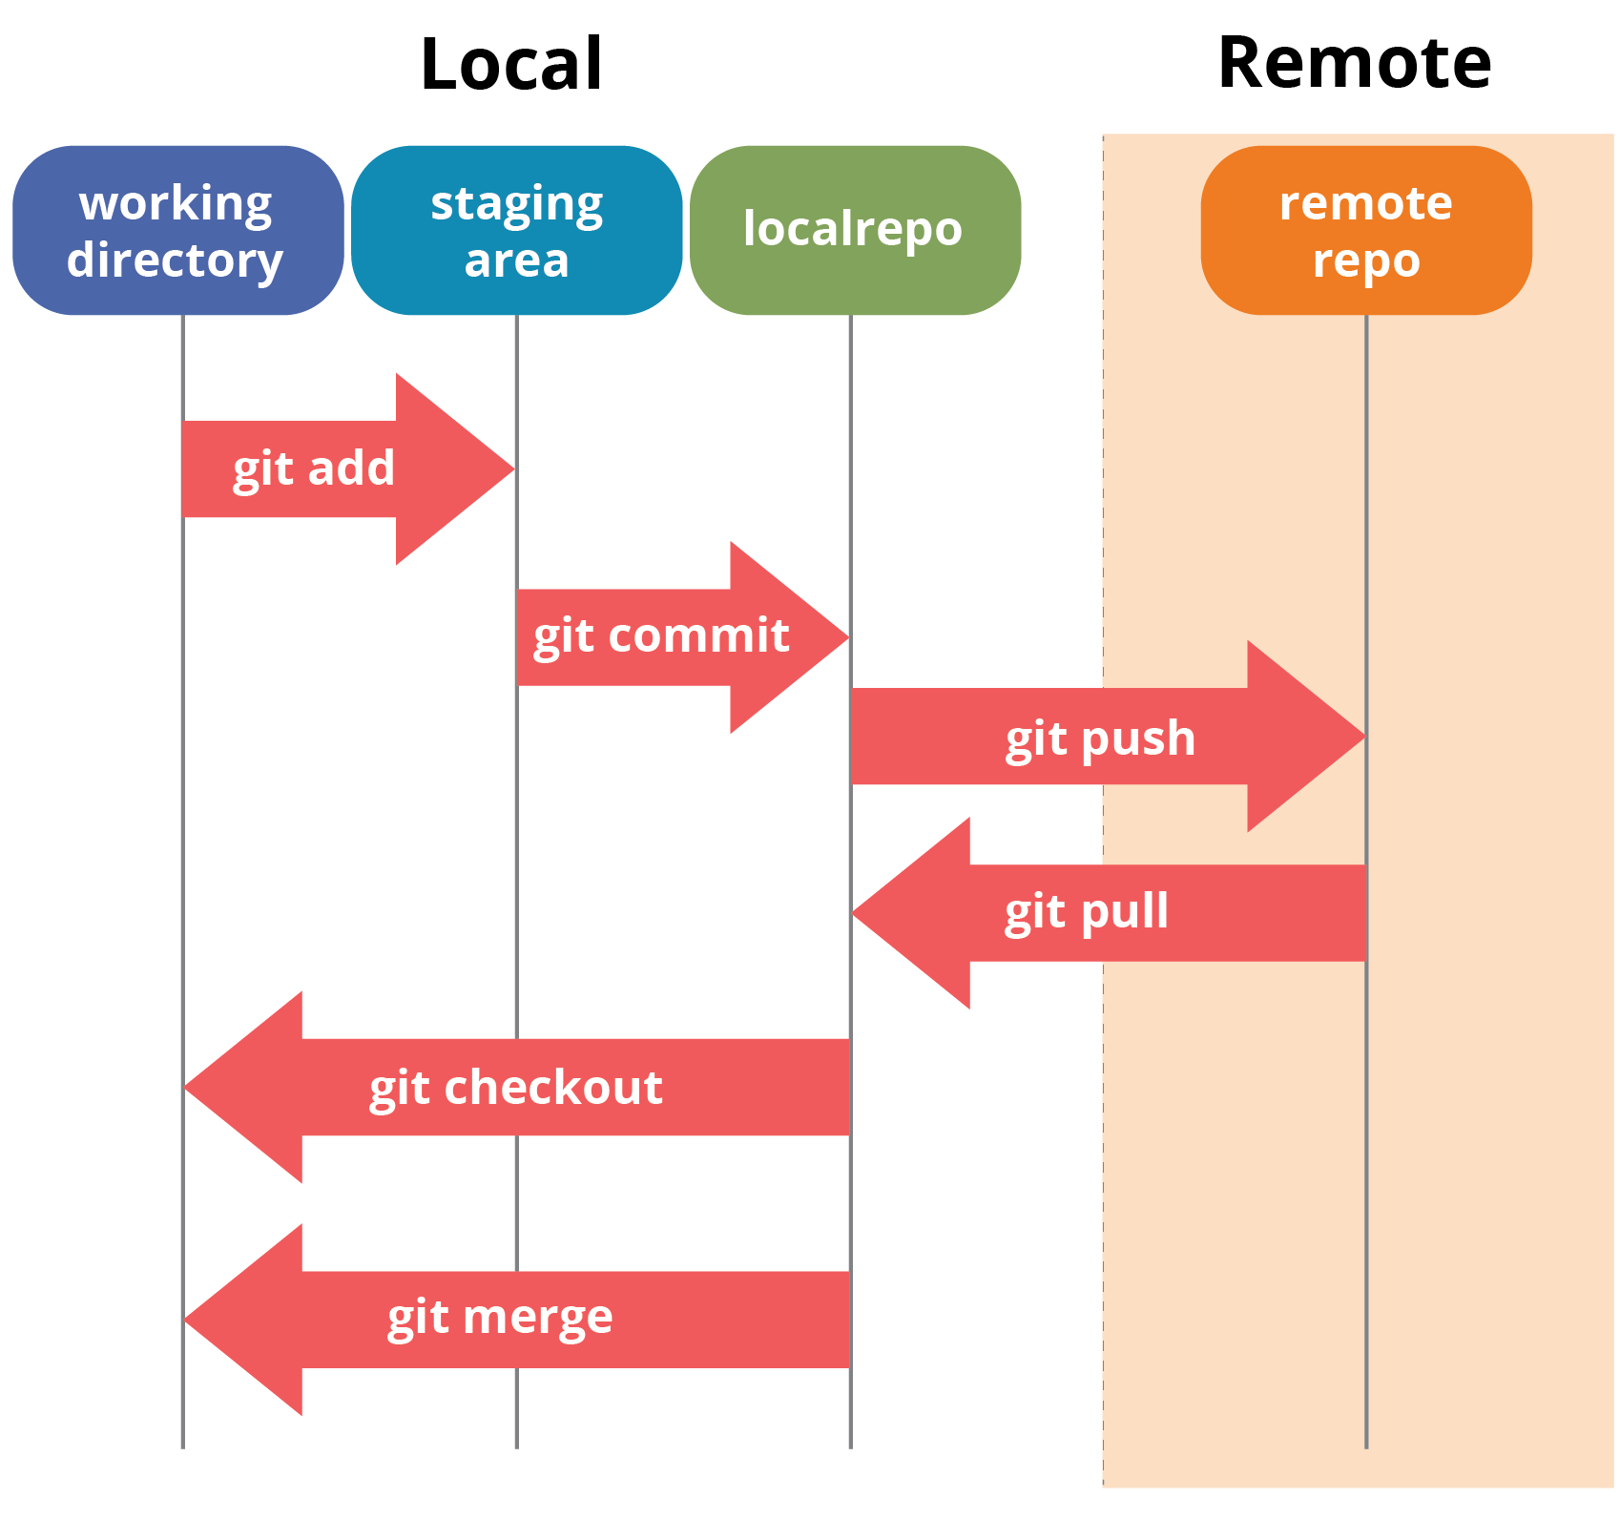
Git
GitHub

Slide 6
Committing files to the repo
$ git add script.py
$ git status
$ git commit –m “Initial commit”

Slide 7

*** Please tell me who you are.
Run
git config --global user.email "you@example.com"
git config --global user.name "Your Name"
to set your account's default identity.

Slide 8
Creating a branch (non-linear)
$ git checkout –b mybranch
$ git branch

Slide 9
What is GitHub?
Hosts Git repositories in the cloud
Provides extra features such as access control, bug tracking, feature requests, task management, etc.
Accounts are free with options for professional and enterprise versions
Subsidiary of Microsoft

Slide 10
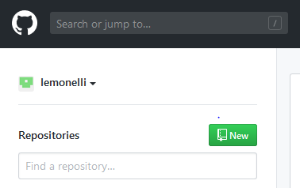
Create a GitHub Repository

Slide 11
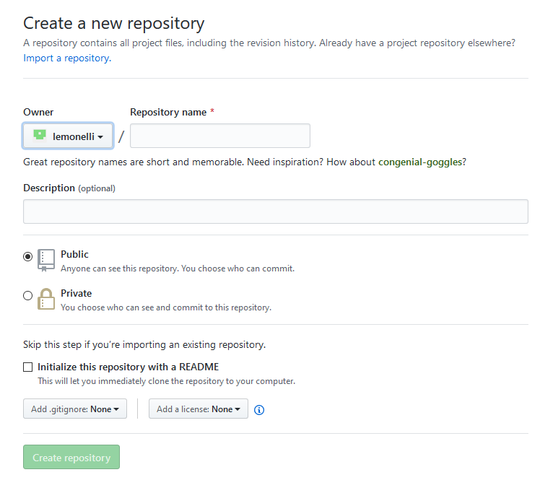

Slide 12
Push your new local repo to your GitHub repo
$ git remote add origin https://github.com/lemonelli/newproject.git
$ git push origin master
$ git push origin mybranch

Slide 13
Cloning a GitHub repo
$ git clone https://github.com/lemonelli/newproject.git

Slide 14
Now create a new file, add, commit, and push

Slide 15
Get updated GitHub repo
$ git pull origin master

Slide 16
Cheat Sheet
$ git init
$ git status
$ git add [file1] [file2] …
$ git commit –m “Commit message”
$ git checkout branch-name
$ git checkout –b branch-name
$ git branch
$ git push origin branch-name
$ git pull origin branch-name
$ git log
$ git clone [GitHub url]
$ git remote add origin [url]
Creates new repo in working directory
Displays basic info about current repo
Adds files to stage
Commits stage to local repo
Switches branches & updates w/ changes
Creates new branch
Displays all branches & current branch
Pushes local changes to GitHub
Pulls GitHub changes to local
Lists recent Git actions
Clones GitHub repo
Adds GitHub location for local repo

Slide 17
For more info
https://git-scm.com/docs

